Slide 1
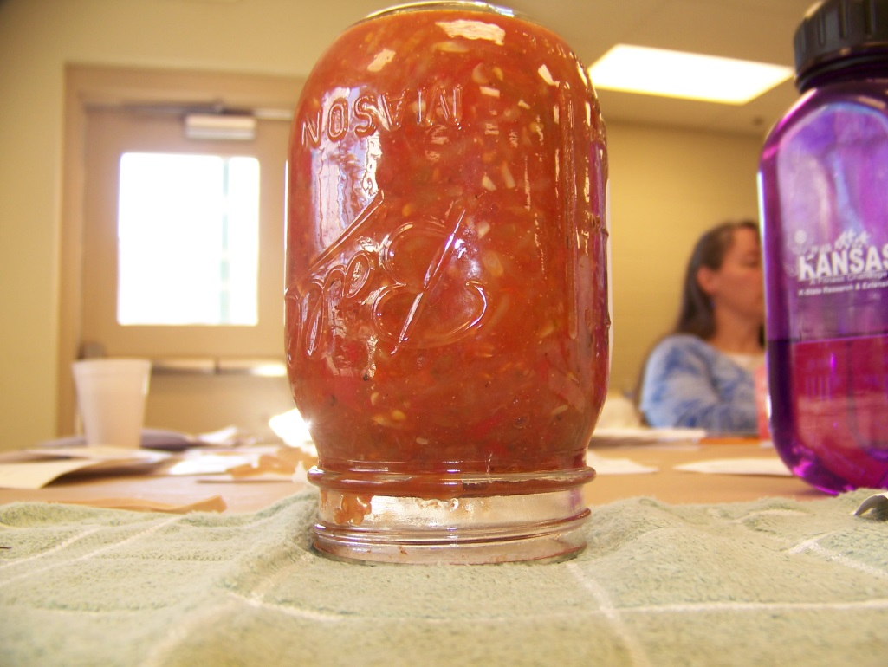
Just Because It Seals, Doesn’t Mean It’s Safe!
Food Safety for Fair Exhibits and Home
Karen Blakeslee, M.S.

Slide 2
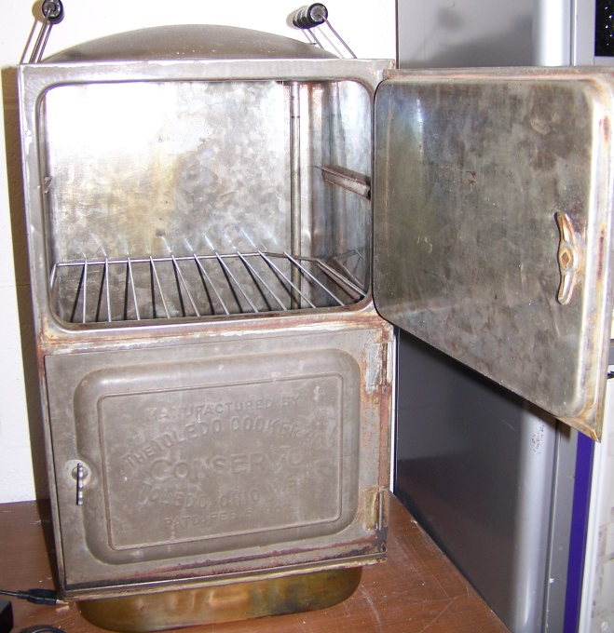
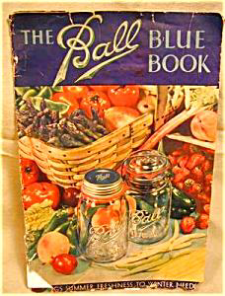
It is the 21st Century!
Just because Grandma did it her way, doesn’t mean it’s safe today!!
It is important to use current food preservation practices

Slide 3
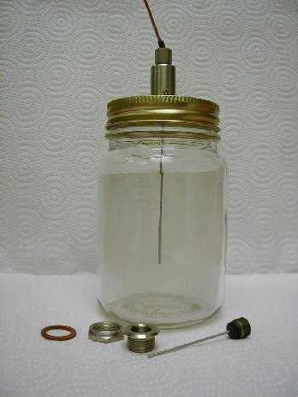
Why Get Up to Date?
Food preservation is a science and things have changed!
pH < 4.6 = high acid foods
pH > 4.6 = low acid foods
Supports growth of botulism!
Water activity
Heat penetration through the jar
Thickness of the food mixture
Size of food pieces
Size of jar
Raw pack or Hot pack
Altitude of residence
Time and temperature
Headspace

Slide 4
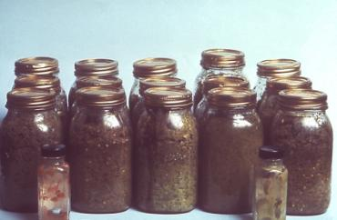
Creative Canning Foodborne Illness!
Improperly home canned vegetables are the most common cause of botulism outbreaks in the U.S.
Did not pressure can
Ignored spoilage signs
Improper instructions
Unaware of the risks
Canned peppers with botulism
CDC – Public Health Imaging Library
http://www.cdc.gov/features/homecanning/

Slide 5
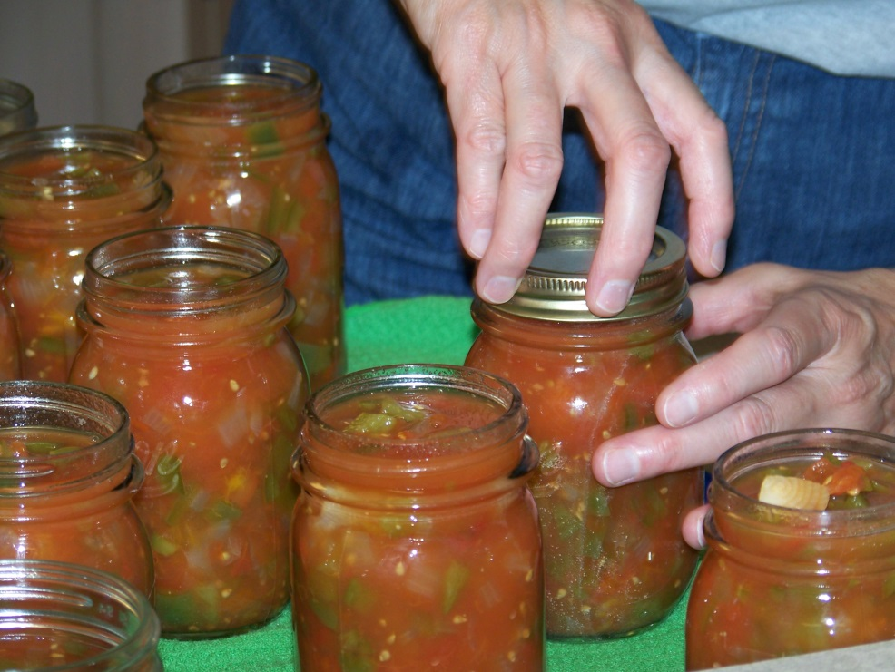
The Basics
Use USDA processing methods with tested recipes
Clear, standard canning jars
High acid foods MUST be water bath processed
Jams, jellies, fruits, pickles
Low acid foods MUST be pressure canned
Vegetables, meats
Tomatoes, with added acid, may be processed either way

Slide 6
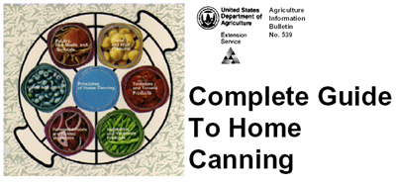
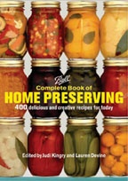
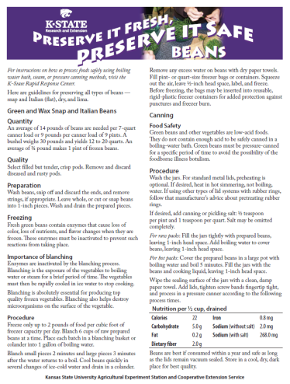
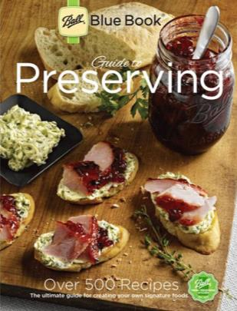
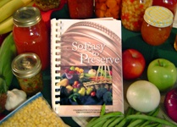
Trusted Recipe Sources
6th edition
Not recommended to can homemade recipes

Slide 7
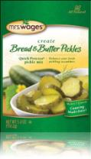
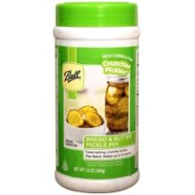
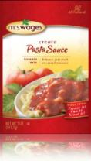
Packaged mixes
For quick and easy canning
Pickles
Salsa
Sauces
Many more!
Follow instructions exactly!!!!
Jarden Home Brands
Notes:
Some can be used fresh or they can be canned for later use.

Slide 8
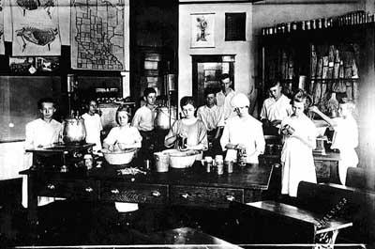
Boys and Girls Club Work, canning demonstration, 1920. Minnesota Historical Society Photography Collection • SA1.31 r30, 81684
Recipes older than 1994 may be unsafe

Slide 9
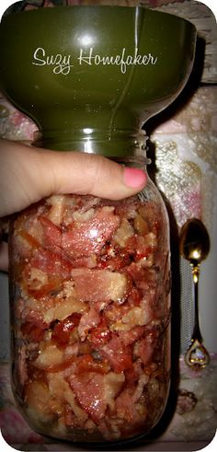
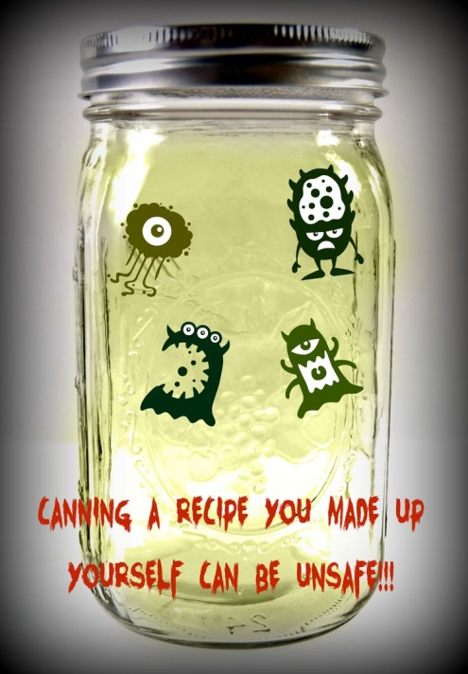
Unsafe Recipes Sources
Just because a food is canned commercially doesn’t mean it can be canned safely at home!!
Blogs
Pinterest
Old recipe books
Recipe magazines
May not be adequately tested
Many others…

Slide 10
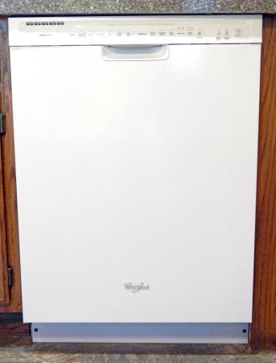
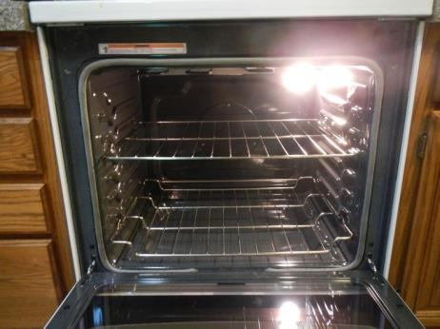
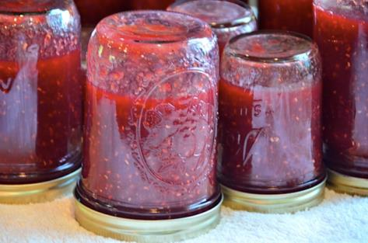
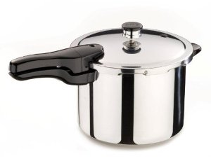
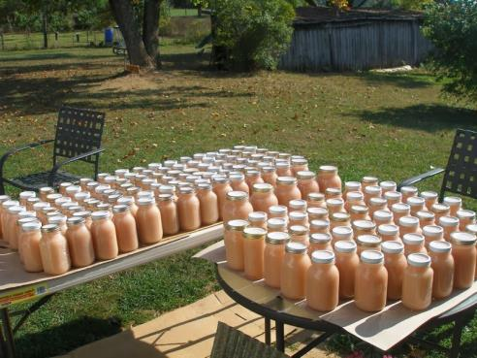
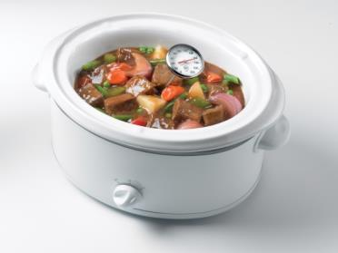
Unsafe Processing
Open Kettle Canning
Dishwasher
Oven or Microwave
Sun Canning
Pressure Cooker
Steam Canning
Slow Cooker

Slide 11
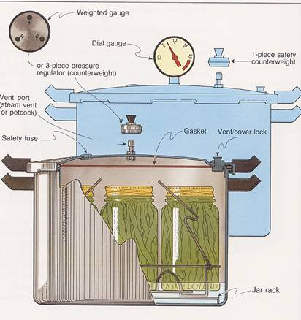
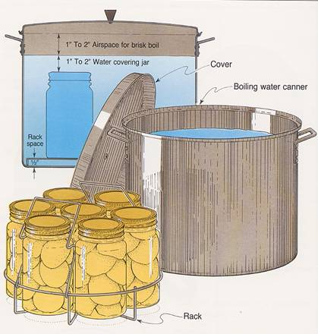
Canning Equipment
USDA Complete Guide
To Home Canning
Pressure Canner – Dial or Weighted Gauge
Water Bath Canner
Notes:
Tips on using pressure canners and water bath canners can be found on the Rapid Response Center web site at http://www.rrc.ksu.edu/DesktopDefault.aspx?tabid=28 under “Other Resources.”
The Ball Blue Book and So Easy to Preserve also give good instructions.
All vegetables and meats MUST be pressure canned.
Fruits, pickles, jams and jellies are water bath canned.
Tomatoes and fruits could also be pressure canned. For fruits, see p. 49 of So Easy to Preserve. Tomato recipes give recommdations for both methods.
Always read manuals before using!

Slide 12
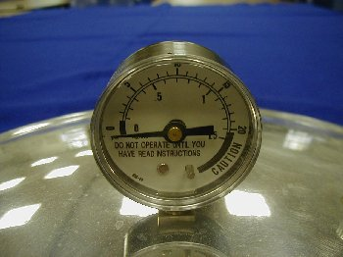
Pressure Gauge Testing
Dial pressure gauges need yearly testing
If more than 1 pound off, replace
Weighted gauges do not need testing
1 pound error in a 20-minute process causes over 10% decrease in sterilizing value
2 pound error a 30% decrease
University of Georgia

Slide 13
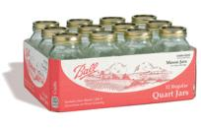
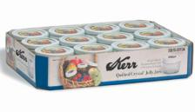
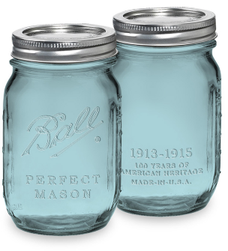
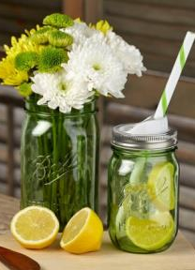
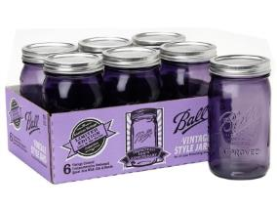
Types of Jars
Use regular or wide-mouth canning jars
4 oz – ½ gallon sizes
½ gallons for fruit juice only
1 gallon not for canning!
Clean, not damaged
No colored jars at fairs!
Mayonnaise jars for water-bath use only
Jarden Home Brands
Notes:
Ball and Kerr products are owned by Jarden Home Brands http://www.freshpreserving.com

Slide 14
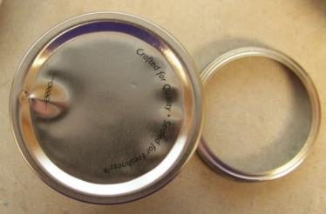
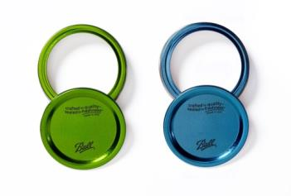
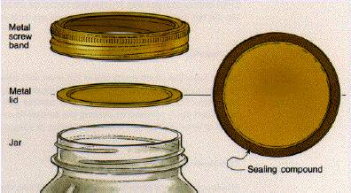
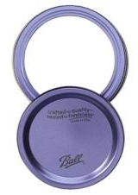
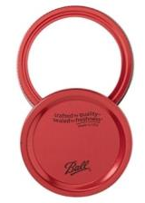
Types of Lids
Use two-pieced lid
Always use new lids
Newer lids don’t need pretreating
Wash with soapy water, rinse
USDA Complete Guide To Home Canning

Slide 15
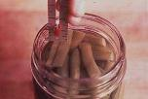
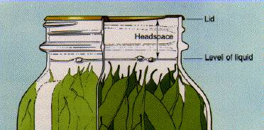
Headspace
University of Georgia
Space in jar between bottom of lid and top of food/liquid
Varies by type of food
Proper headspace creates vacuum seal
Usually:
1/4” jellied fruit products
1/2” fruits, tomatoes and pickles
1” to 1-1/4” low acid foods
USDA Complete Guide To Home Canning
Notes:
If jars are too full, the contents may boil out during processing. Food pieces can get caught under the lid sealing compound and prevent lid from sealing.
Too much headspace can leave excess air in the jar and prevent a tight seal
In general…
1 inch headspace for vegetables and meats
½ inch headspace for pickles, relishes, fruits and tomatoes
¼ inch headspace for juices, jams, jellies
Always use headspace recommended in tested recipes.

Slide 16
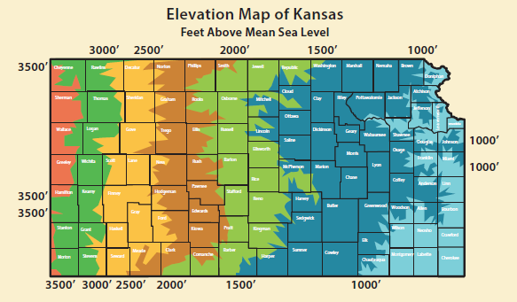
Adjusting for Altitude
This is the number one reason for disqualification!!
How to Adjust
Boiling Water Bath
time
Pressure Canning
pressure
Search Kansas Elevation Data at http://geonames.usgs.gov/pls/gnispublic
http://www.ksre.ksu.edu/bookstore/pubs/MF3172.pdf
Notes:
Recipes in So Easy to Preserve are based on an altitude of 0 – 1,000 feet. Tables are provided in each section to adjust for higher altitudes.
The Ball Blue Book recipes are based on an altitude of 0-1,000 feet. See chart on page 5 to adjust for higher altitudes.

Slide 17
Processing Time
Each food and preparation style has its own processing time
Time differs with size of jar
Too Little (Underprocessing)
Spoilage
Too Much (Overprocessing)
Overcooked
After removing canner lid…
Let jars sit in canner for minimum of 5 minutes

Slide 18
Sensational Salsa!
Please do not experiment with canning your own recipe that mixes low-acid vegetables together, even with “some” acid like vinegar or lime juice. If done improperly, you put yourself at risk for botulism, a potentially fatal food poisoning.
http://nchfp.uga.edu/publications/nchfp/factsheets/salsa.html
http://www.ksre.ksu.edu/bookstore/pubs/MF3171.pdf

Slide 19
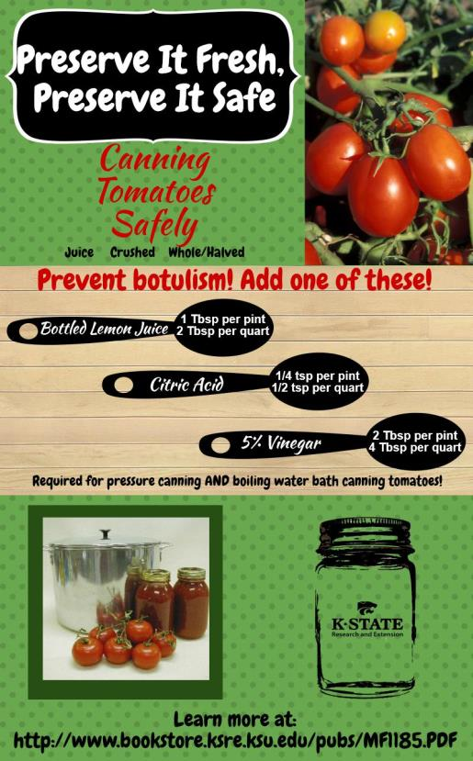
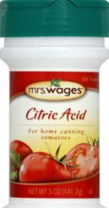

Tomatoes Need Acid
All Tomatoes have pH between 4 - 4.6
Borderline for safe boiling water canning
This includes all colors of tomatoes!
For Pints
1 Tablespoon bottled lemon juice
¼ teaspoon citric acid
For Quarts
2 Tablespoons bottled lemon juice
½ teaspoon citric acid
Notes:
Do not can tomatoes from dead or frost-killed vines. The acid level has changed too much to can them safely with current recommendations.
Yellow tomatoes are canned by the same method as red tomatoes. This holds true for pink, orange, and other rainbow colors of ripe tomatoes, so you can mix and match as you preserve salsa or canned tomato products.
Using bottled lemon juice gives a consistent acid treatment. Fresh lemon juice acidity varies.
Mrs. Wages sells citric acid.

Slide 20
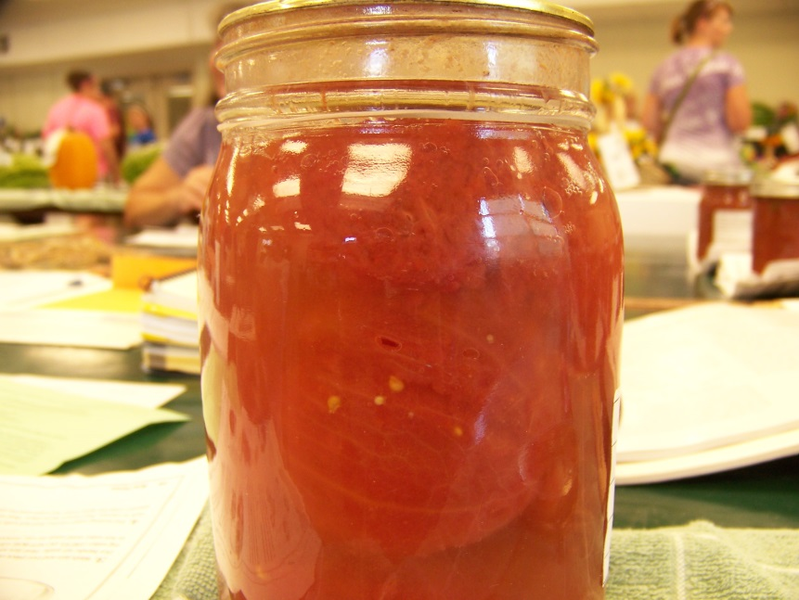
More on Tomatoes
Vinegar may be used, but….
4 Tablespoons vinegar per quart or 2 Tablespoons per pint
Flavor may be objectionable
Add acids directly to jar before filling
If too acidic, add sugar to taste
Example: 1 tablespoon per quart
Fermenting tomatoes

Slide 21
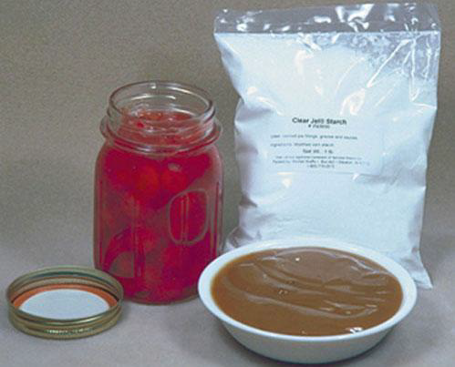
Pie Filling
Must use Clear Jel® as thickener
This will not break down during processing, which would cause a runny filling
Regular corn starch or flour will get clumpy or separate due to repeated heating.
Think clumpy gravy!
Notes:
Where you get Clear Jel

Slide 22
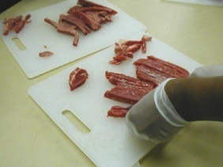
Safety of Jerky
Jerky
Must be heated to 160°F
Heat in marinade prior to drying
Heat in 275°F oven for 10 minutes after drying
Strips should be ¼-inch thick or less
http://nchfp.uga.edu/how/dry/jerky.html
Recipe needs to reflect the heating method
University of Georgia
http://www.ksre.ksu.edu/bookstore/pubs/MF3173.pdf
Notes:
Use only lean meat.
Partially freeze, slice thin.
Do not use untreated pork
To treat, freeze 6” or less piece at 5ºF for 20 days.
Marinate.
Dry when cracks but does not break when cool.
Indoor drying only.
Warning: Eating jerky that has been dried at low temperatures (140 degrees F or below) may pose bacterial risk.
To reduce risk: Meat should be heated to 160 degrees F.
Safer Preparation of Jerky
Two methods of treatment possible:
Heated prior to drying.
Bring refrigerator cold strips and marinade to boiling and boil for 5 minutes.
Drain.
Place in dehydrator pre-heated to 140ºF.
2. Heated after drying.
Pre-heat oven to 275ºF.
Place dried strips on cookie sheet not touching or overlapping.
Heat 10 min at 275ºF.
*These directions work only if directions for thickness of strips were followed.

Slide 23
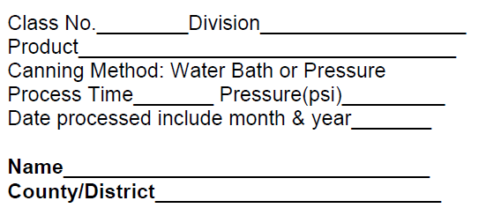
Labels for Jars
Altitude of residence________________
http://www.kansas4-h.org/events-activities/fairs/kansas-state-fair/
Scroll down to “Food Preservation”

Slide 24
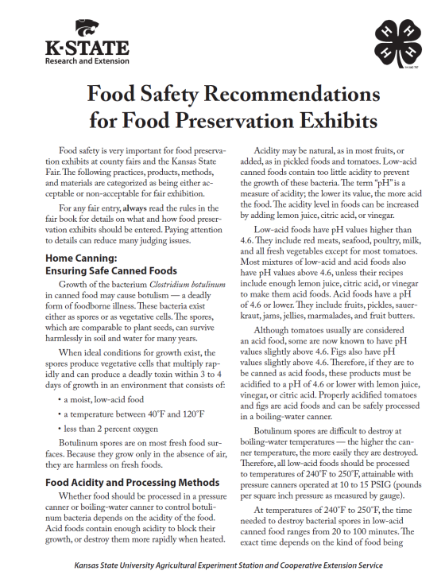
Judging Standards
http://www.kansas4-h.org/events-activities/fairs/kansas-state-fair/index.html
Judging Scorecards
Canned Fruits and Tomatoes
Canned Meats
Canned Pickled Products
Canned Vegetables
Dried Fruits and Leathers
Dried Vegetables and Herbs
Fruit Preserves
Meat Jerky

Slide 25

READ
THE
RULES!
FAIR BOOK

Slide 26
What Judges Consider
Disqualification Jar unsealed No label, missing information Wrong processing method Underprocessing Jerky not heated to 160°F Jar bigger than recipe states Added thickeners, rice, pasta Moving bubbles Not acidifying tomatoes Mashed or pureed pumpkin/winter squash Paraffin wax on sweet spreads Untested recipe source Contains alcohol | Lowering a Ribbon Placing Not following fair book rules No recipe Different color rings/ bands Messy jars, rusty rings Not enough liquid Improper headspace Wrong color (artificial color added if not in recipe) Food over mature Uneven sized food pieces Using colored jars Brands of jar/lids not the same Food above liquid Fancy pack, if not stated in recipe Foreign material Sediment in jars Using iodized salt

Slide 27
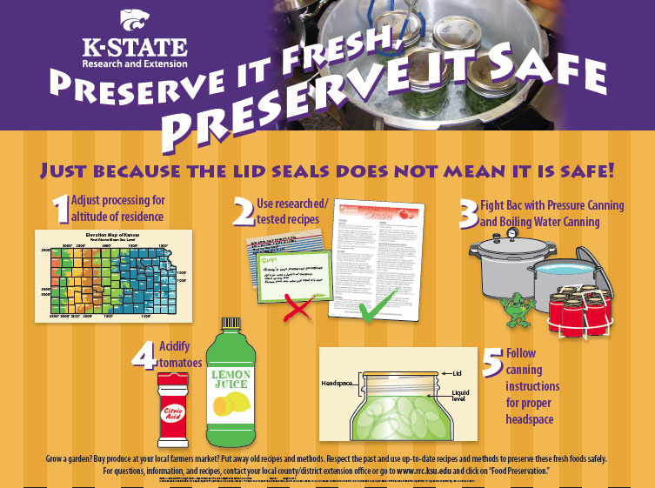
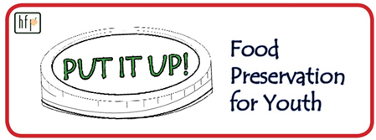


Get Educated!
4-H Foods Project Curriculum and online resources
http://nchfp.uga.edu/putitup.html
http://www.rrc.ksu.edu/p.aspx?tabid=18
10 Tips for Safe Home-Canned Foods
http://www.ksre.ksu.edu/bookstore/pubs/MF3170.pdf
http://nchfp.uga.edu/

Slide 28
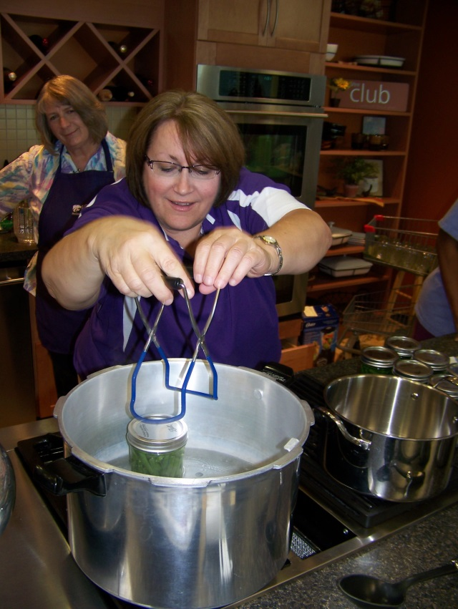
For the Fair AND Home!
This is not JUST for the Fair!!
All foods need to be canned safely for any use!
Be Smart!
Be Safe!

Slide 29
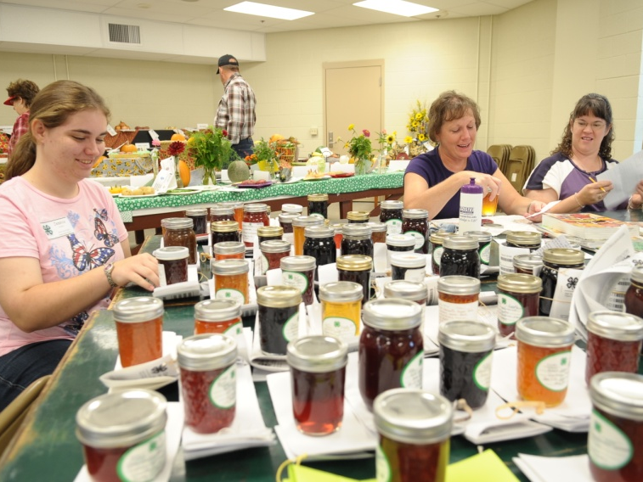
Need a judge’s training, leader’s training? Food preservation class? Resources?
How Can I Help?

Slide 30
Just Because It Seals, Doesn’t Mean It’s Safe!
Food Safety for Fair Exhibits and Home
Karen Blakeslee, M.S.

