Slide 1
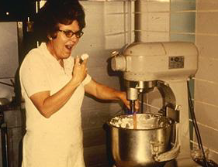
It’s More Than Keeping Your Fingers Out of the Cookie Dough!
Food Safety for Fair Exhibits
Karen Blakeslee, M.S.

Slide 2
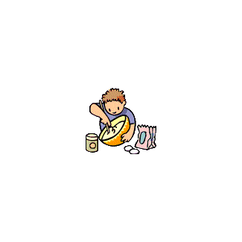

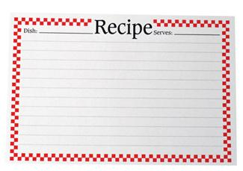
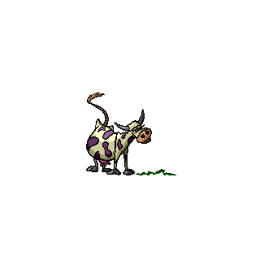




The Road to the Fair

Slide 3

Why is Food Safety Important?
Every time you cook or bake in the kitchen you are doing a science experiment!
Not all recipes are appropriate for the fair!!
Be smart about food safety!!

Slide 4
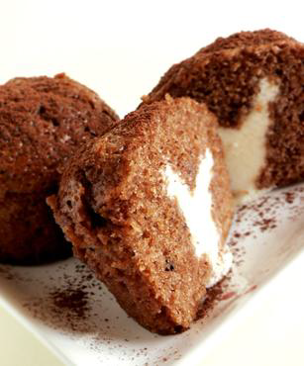
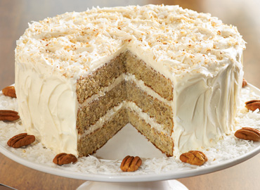
Is This Food Exhibit Safe?
Ask Yourself…
  Does this food require refrigeration?
  Would you eat this food at room temperature?
  Will this product hold up to its standard when it is judged or displayed?
Food Safety violations will be disqualified!

Slide 5
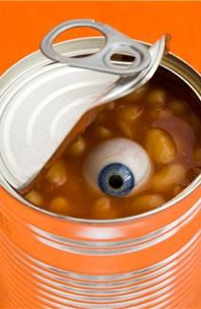
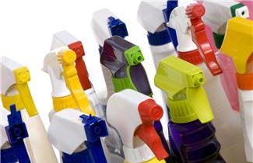
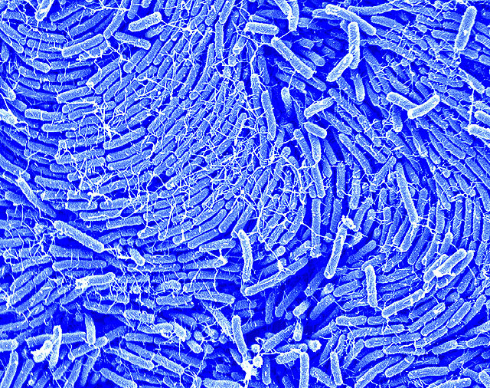
What Makes a Food Unsafe?
Three categories of hazards
Chemical
Physical
Biological

Slide 6
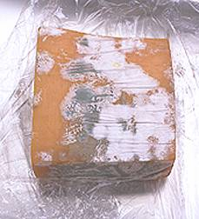
Microorganisms
Biggest risk to humans
Loss of shelf life
Loss of product quality
Can lead to foodborne illness

Slide 7


Conditions for Growth
F Food | A Acid | T Time
T Temperature | O Oxygen | M Moisture

Slide 8
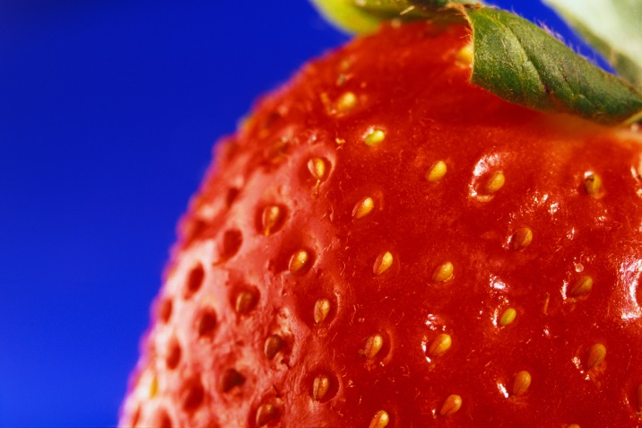
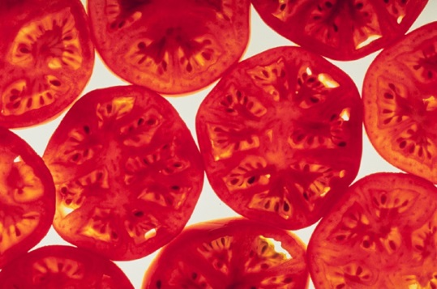
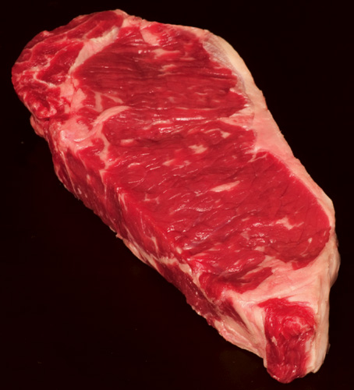
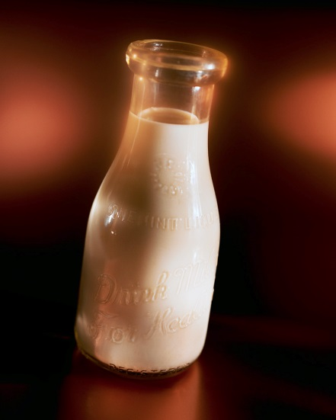
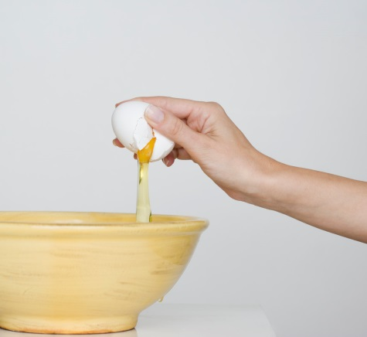
What Grows Where?
Bacteria, yeast, and molds can grow on just about any food
  They really like carbohydrates and proteins
What foods spoil the quickest?
  These are the ones of concern

Slide 9
Food Safety at the Fair
What is perishable?
  High in moisture, protein and neutral acidity
  Anything that needs refrigeration
Many fairs have a Perishable Foods class
  Bring at proper temperature, judge, take home
Perishable foods are good options for a Favorite Food Show
County Fairs that have refrigeration can allow perishable exhibits
  Not allowed at State Fair 4-H Foods!

Slide 10
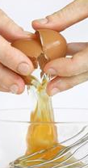
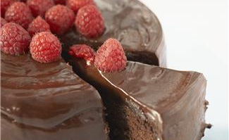
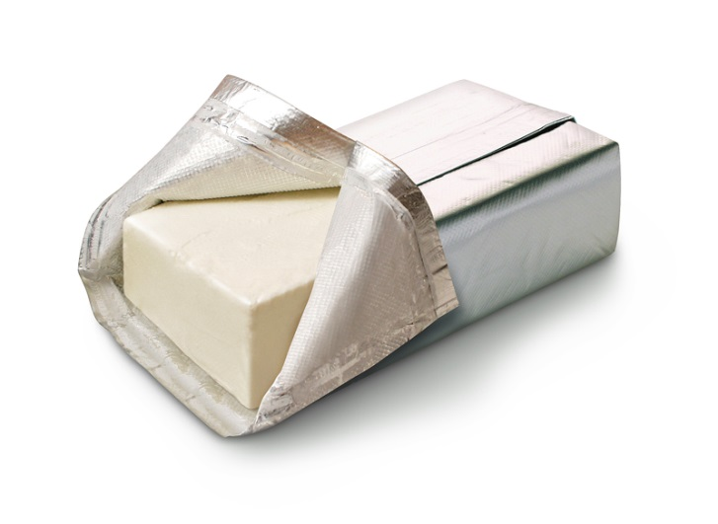
Perishable Foods
Icings and frostings made with RAW eggs
Cream cheese frosting
Chocolate Ganache
Heavy cream frosting
Lemon curd
NOT ACCEPTABLE!

Slide 11
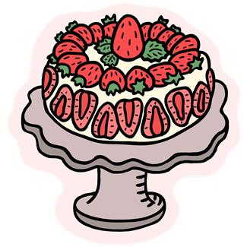
Perishable Foods
Fresh fruit OR vegetable as a garnish
  Once a fruit is cut it must be refrigerated
  Many whole fruits need refrigeration
    Strawberries
    Raspberries
  Many vegetables need refrigeration after harvest
    Peppers
NOT ACCEPTABLE!

Slide 12
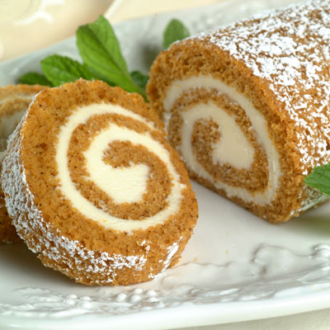
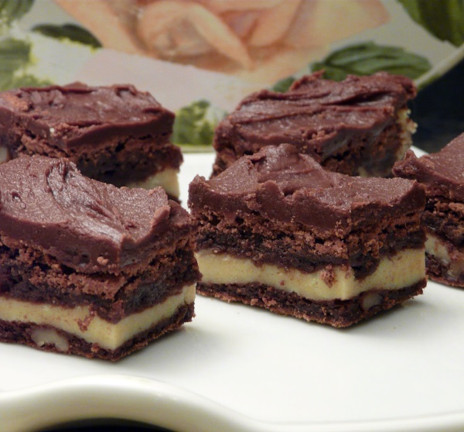
Fillings with High Amount of Dairy
Any Dairy based filling
  Cream cheese
  Sour cream
  Ricotta
Moisture level is higher in the filling and the food would need refrigeration to prevent microbial growth
NOT ACCEPTABLE!

Slide 13
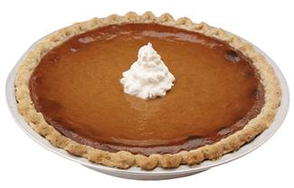
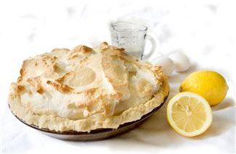
Pies
Custard Pie
  Pumpkin
  Cheesecake
Cream/Meringue Pie
  Coconut
  Chocolate
  Lemon
  Any flavor!
Strawberry pie
Chiffon pie
Bacteria can multiply in these moist desserts high in dairy and eggs
NOT ACCEPTABLE!

Slide 14
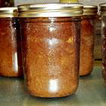
Bread or Cake in a Jar
Jars should not be used in oven
  Per manufacturer
Sealed jar creates anaerobic environment that supports growth of Botulism!
NOT ACCEPTABLE!

Slide 15
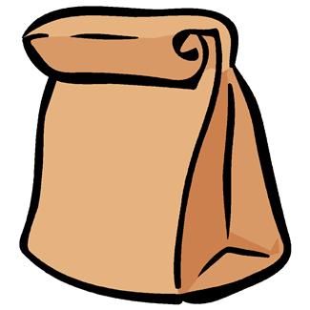
Baking in Brown Paper Bags
“Do not use brown paper bags from the grocery or other stores for cooking. They are not sanitary, may cause a fire, and may emit toxic fumes. Intense heat may cause a bag to ignite, causing a fire in the oven and possibly contaminating the food. The ink, glue, and recycled materials in paper bags may emit toxic fumes when they are exposed to heat. Instead, use commercial oven cooking bags.”
http://1.usa.gov/1zWb30D
NOT ACCEPTABLE!

Slide 16
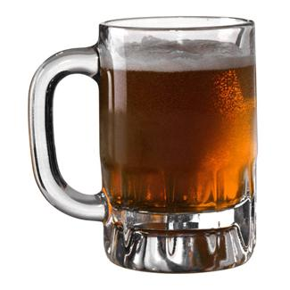

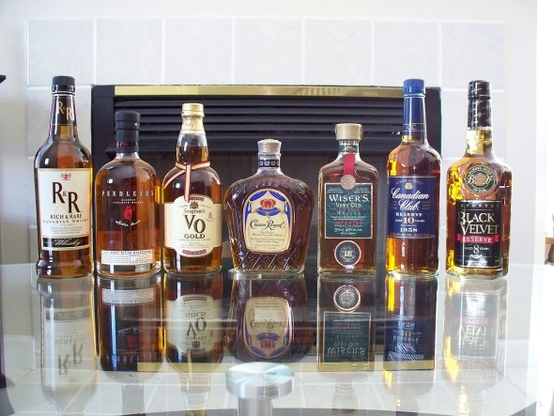
Say NO to Alcohol!
4-H Youth are not of legal age to purchase or possess alcohol
Not all of the alcohol is evaporated or baked off during cooking or baking.
  Alcohol retention ranged between 4% and 85%
  Depends on severity of heat treatment
NOT ACCEPTABLE!
http://uafanswers.com/detail.php?id=128

Slide 17
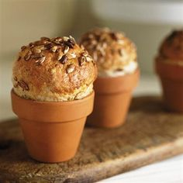
Cooking in Clay Pots
Non-glazed terra cotta clay pots
  Flower pots
  Not food grade
  May contain lead
Use pots with food grade glaze
  Labeled for food use
NOT ACCEPTABLE!

Slide 18
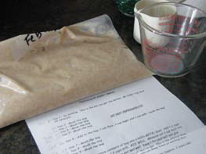
Friendship Bread Safety
If starter was NOT fermented in the refrigerator, it will NOT be acceptable
  Studies have shown that Salmonella and Staphylococcus aureus can grow during prolonged fermentation at room temperature
Typically use milk which can spoil
NOT ACCEPTABLE!
http://www.foodsafety.wisc.edu/assets/pdf_files/friendship_bread.pdf

Slide 19
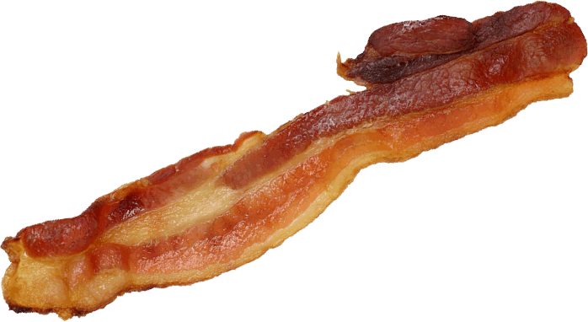
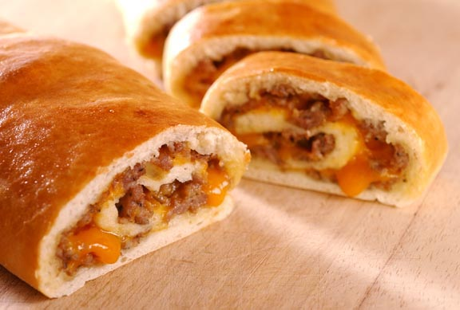
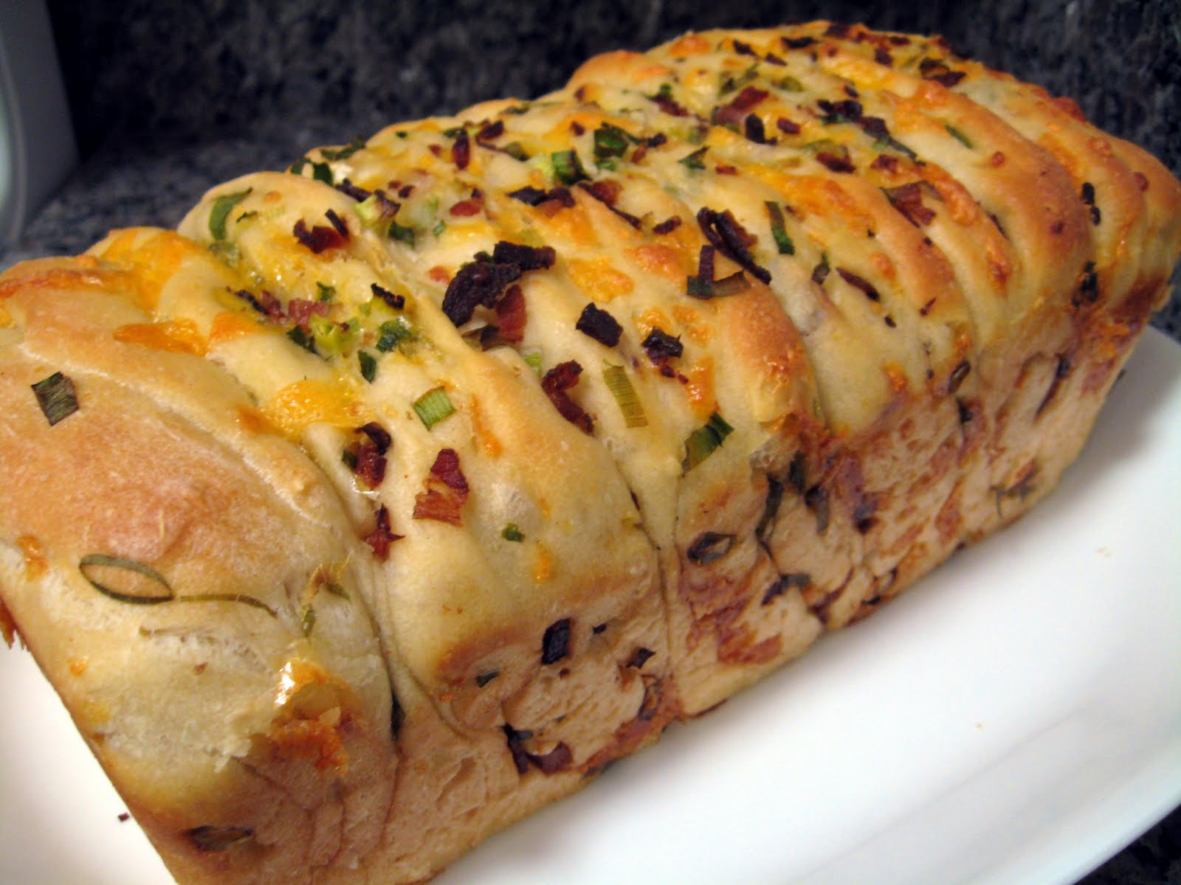
Bacon or Meat
Meat is perishable
May not be completely cooked
NOT ACCEPTABLE!

Slide 20
Flavored Oils
Herbs, vegetables, and garlic in oil
  Garlic in oil has caused Botulism
  Must be refrigerated
Flavored vinegars are safe
www.ext.colostate.edu/pubs/foodnut/09340.html
OILS NOT ACCEPTABLE!

Slide 21
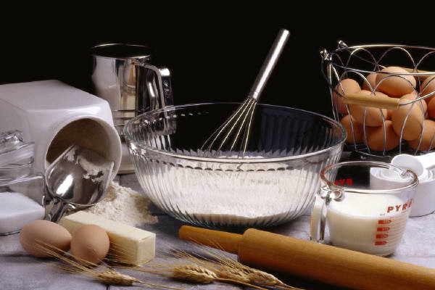
What is Safe and Non-Perishable?
Dairy products incorporated into the entire batter
  Not as separate layer
Examples include
  Cream cheese
  Sour cream
  Milk
  Cream
These get baked into a drier environment
ACCEPTABLE!

Slide 22
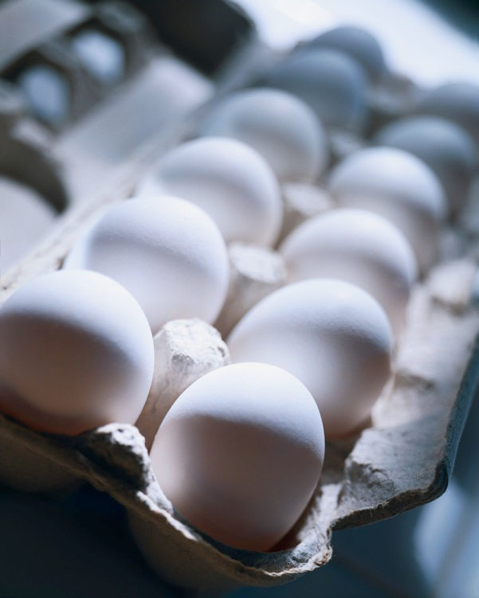
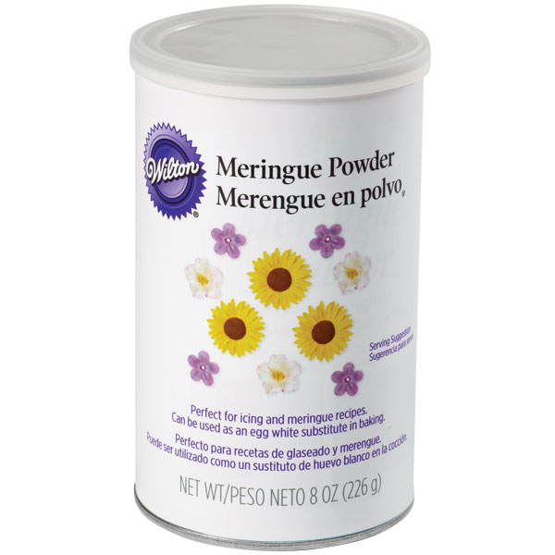
What is Safe and Non-Perishable?
Eggs mixed into the batter and baked
Egg glazes on top of breads prior to baking
Egg white powder
  Meringue powder
  Used in place of raw egg whites for frosting
Egg in pie crust
ACCEPTABLE!

Slide 23
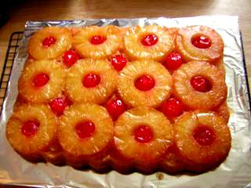
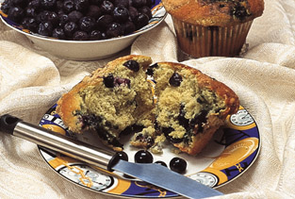
What is Safe and Non-Perishable?
Fruit baked into a product
  Pineapple Upside Down Cake
  Blueberry muffins
ACCEPTABLE!

Slide 24
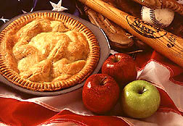
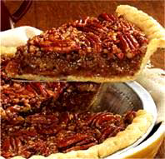
What is Safe and Non-Perishable?
Fruit Pie
  High sugar content takes moisture away from bacteria
  Baking reduces bacteria issues
  Exception is refrigerated pie like Strawberry
Pecan or any Nut Pie
  High sugar binds up moisture making it unavailable for bacteria to use
ACCEPTABLE!

Slide 25
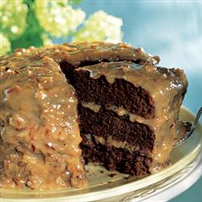
What is Safe and Non-Perishable?
Frostings/Icings
  High sugar content suppresses bacterial growth
  Use small amount of liquid
    Milk, juice, water
  Add flavorings
    Cream cheese flavor
    Fruit flavor
  Shortening withstands heat better than butter
  German Chocolate Frosting
  Commercial frosting
    If permitted at your fair
    Note in the recipe
ACCEPTABLE!

Slide 26
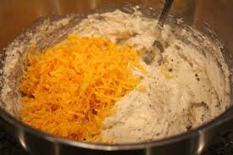
What is Safe and Non-Perishable?
Cheese mixed into batter
  Hard Cheese
    Shredded Cheddar
  Cottage Cheese
  Ricotta Cheese
  Cream Cheese
These are baked into a dry environment, less moisture
ACCEPTABLE!

Slide 27
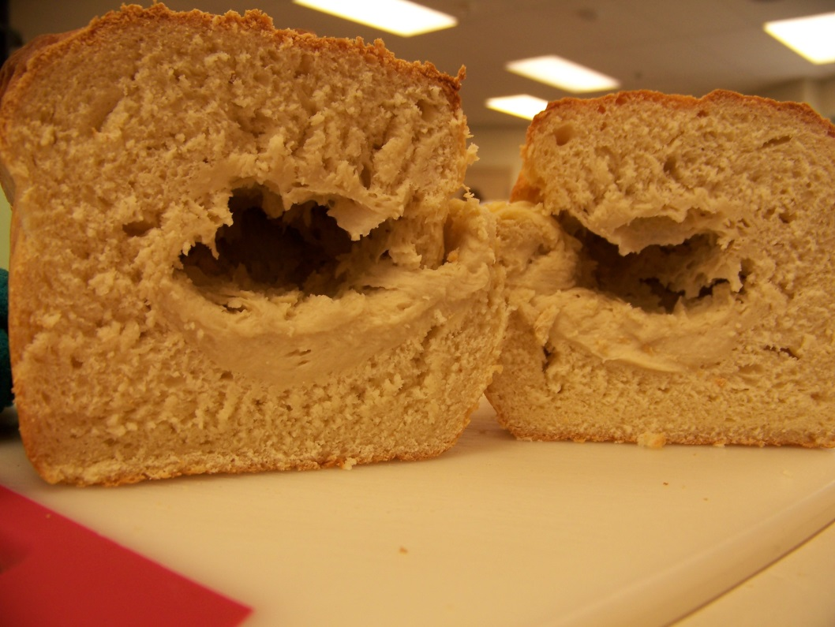
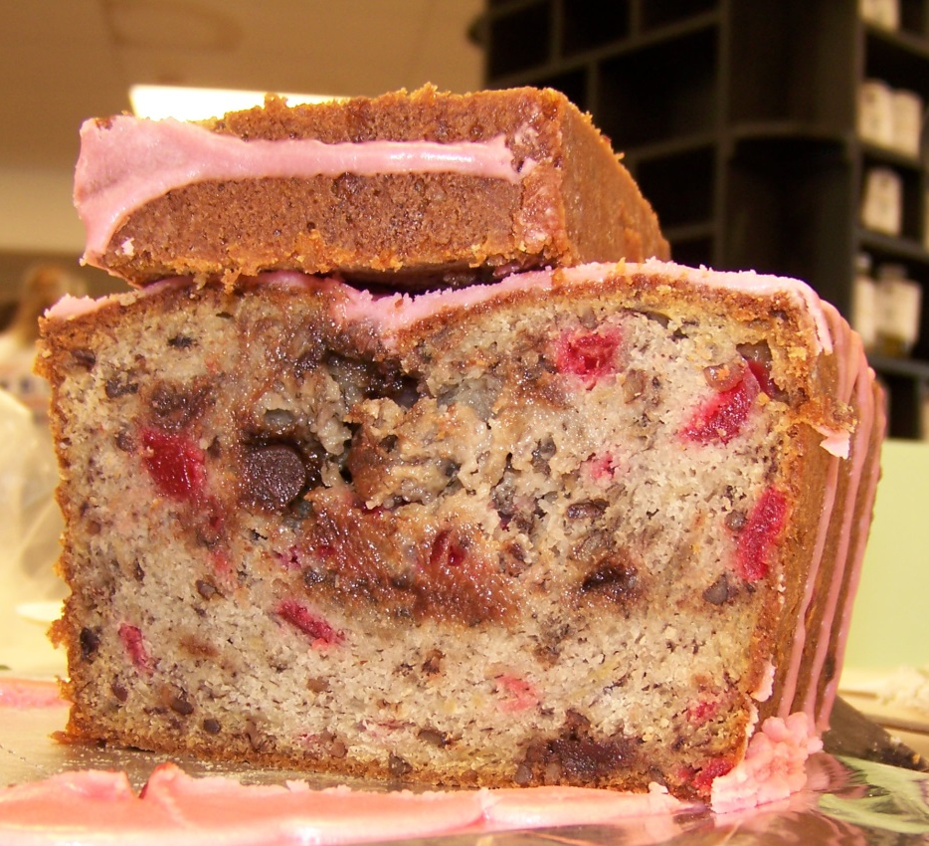
Underbaked Foods
White Ribbon at State Fair
What do you think?
Will be dropped at least one ribbon placing

Slide 28
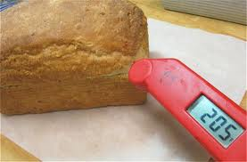
When Are Baked Goods Done?
Internal temperatures
Layer cakes - 205-210°F
Pound cake - 210°F
Jelly roll cakes - 190-195°F
Muffins - 210°F
Quick bread - 210°F
Yeast bread - 195-210°F
Bundt cake - 212°F
Yeast rolls - 190-195°F
Seeing a thermometer hole is OK!
Insert thermometer into the end or side to reach the middle of the bread

Slide 29
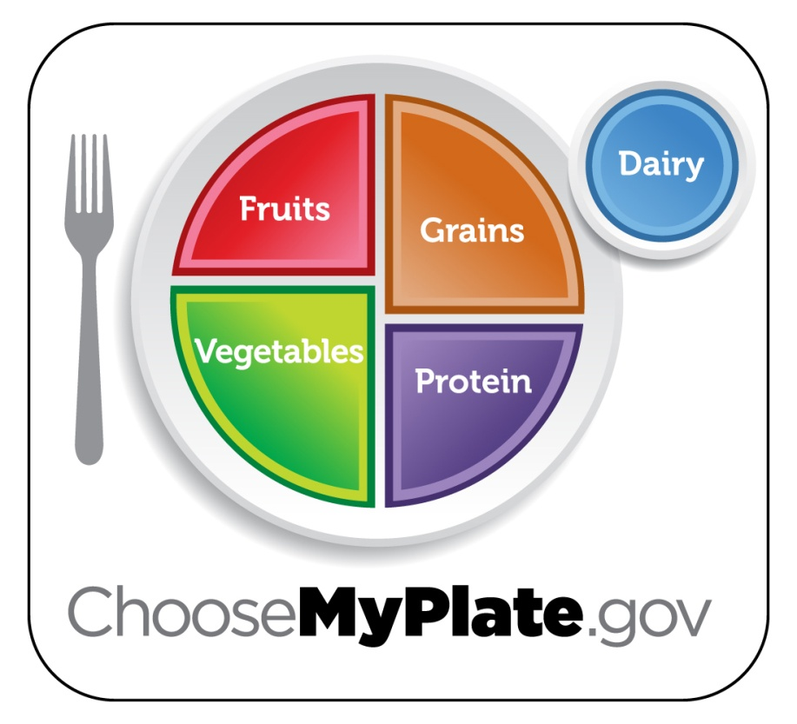
Is it Nutritious?
Consider the Dietary Guidelines
Use of whole grains, fiber
Low in fat
Low in sodium
Reduce added sugars
Proper portion size
Prize winners do not always = high fat or high sugar!

Slide 30
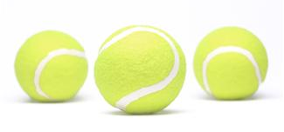
Portion Size
Portion size!
  Bar cookies – 2-inch
  Drop cookies – 2 half dollar coins
  Cinnamon roll – hockey puck
  Roll – bar of soap
  Muffin – tennis ball
  Biscuit – hockey puck

Slide 31
Modified Foods Class
Original recipe changed to improve nutritive value or fit diet needs
Standard Blueberry Muffin recipe changed by:
  All purpose flour replaced with whole wheat flour
  All purpose flour replace with gluten free flours
  Fat content changed by using fruit puree
A recipe already gluten-free is NOT a modified food!

Slide 32
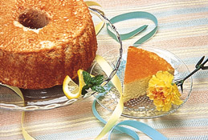
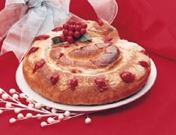
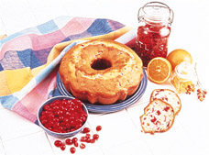
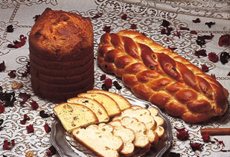


So What Can Be Entered at a Fair?
There are thousands of recipes!!
PRACTICE! PRACTICE! PRACTICE!

Slide 33

READ
THE
RULES!
FAIR BOOK

Slide 34


For Judge’s, Leaders, Parents, Youth
Foods Label
http://www.kansas4-h.org/events-activities/fairs/kansas-state-fair/docs/foods-and-nutrition/Foods_Label.pdf
http://www.ksre.ksu.edu/bookstore/pubs/4H488.pdf

Slide 35

Need a judge’s or leader’s training?
Need a foods training?
How can I help?

Slide 36
It’s More Than Keeping Your Fingers Out of the Cookie Dough!
Food Safety for Fair Exhibits
Karen Blakeslee, M.S.

